Slide 1

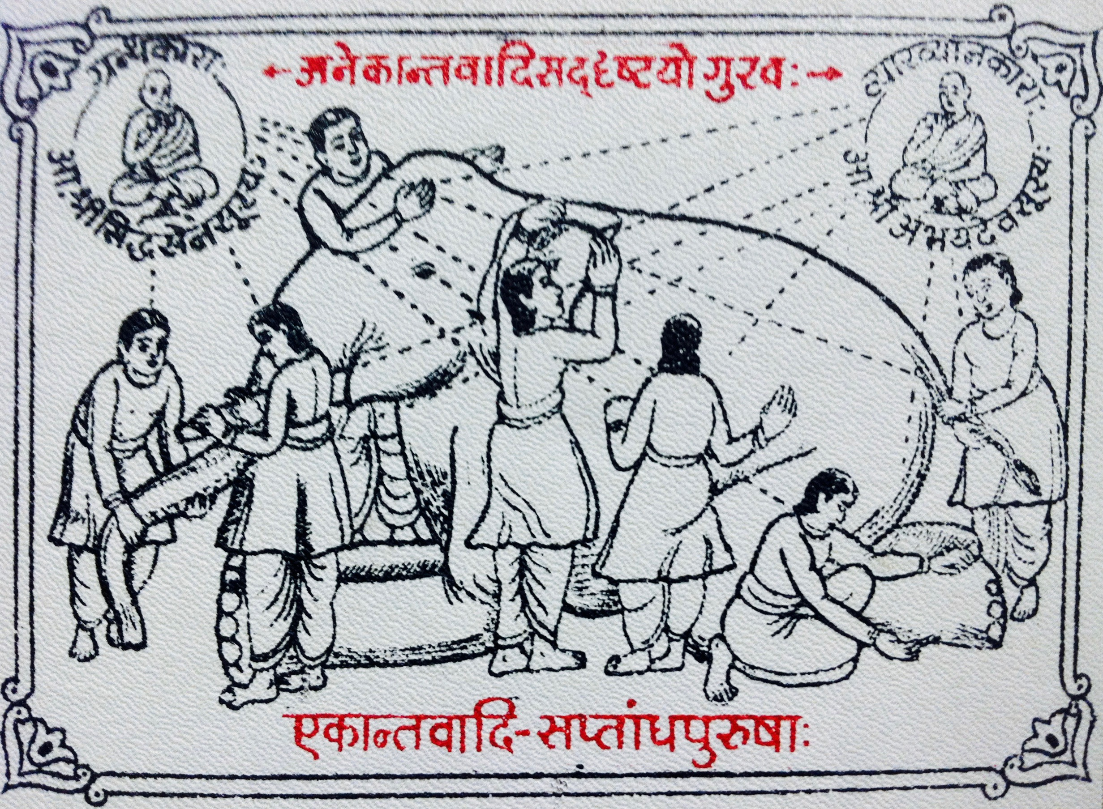
Integrating the Elephant:
Six fields and global risk
Dr Matt Boyd
Society for Risk Analysis: Christchurch
29 January 2026

Slide 2

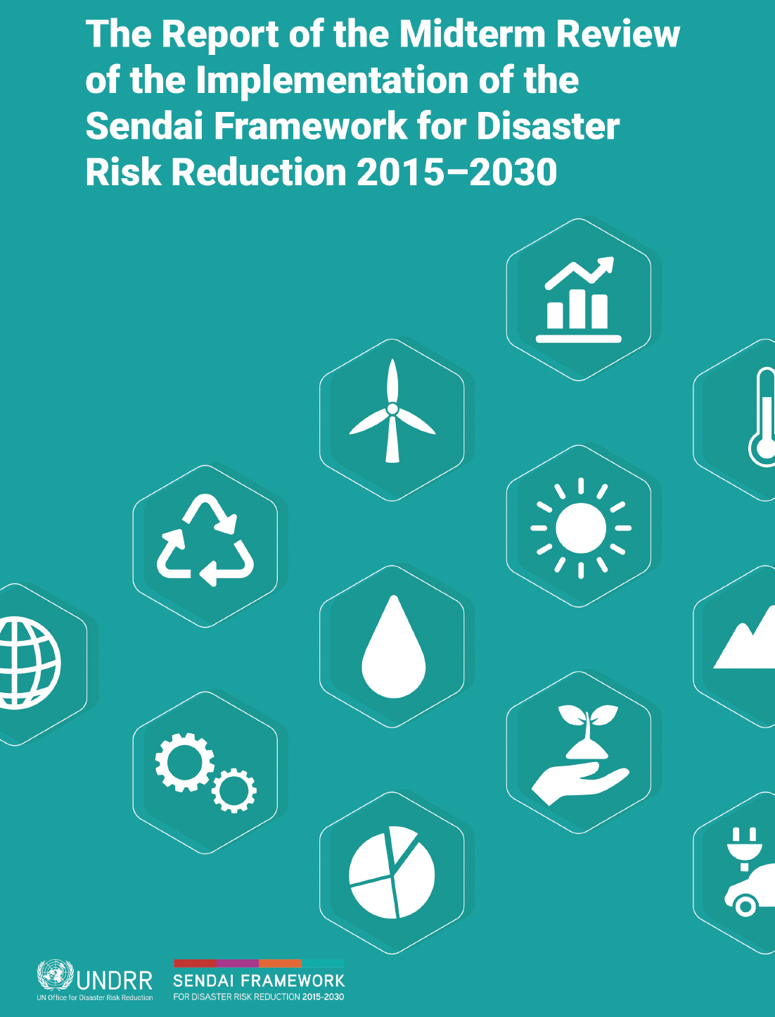
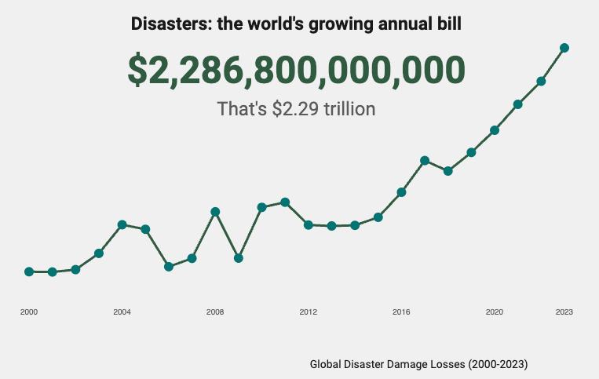
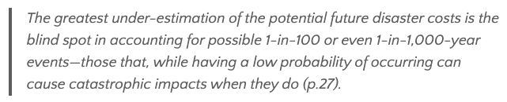
Disaster risk reduction research & practice
Clockwise: Sendai Mid-term Review; UN GAR 2025; Ibid

Slide 3
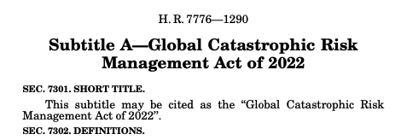
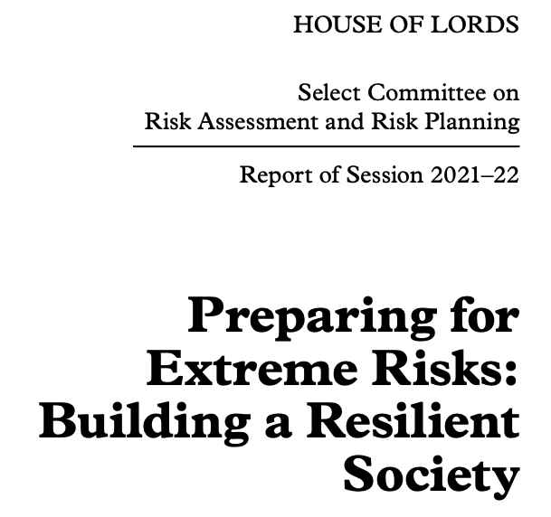
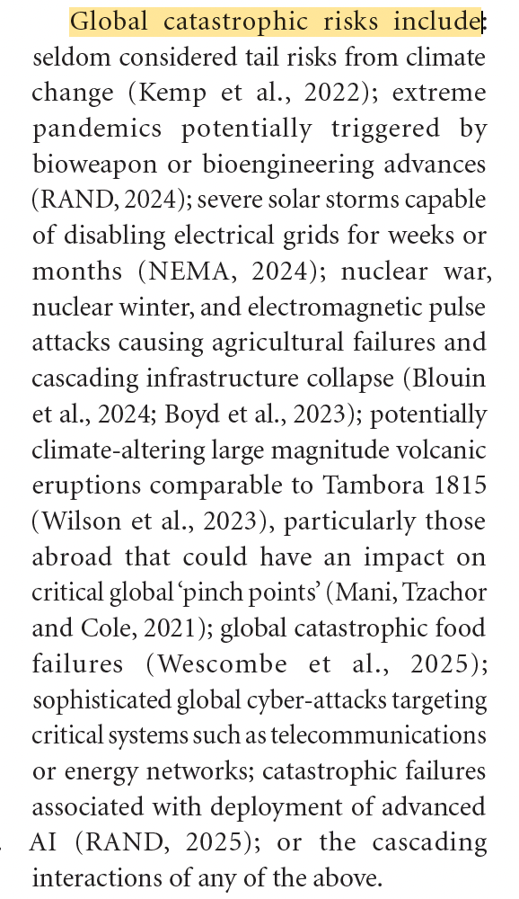
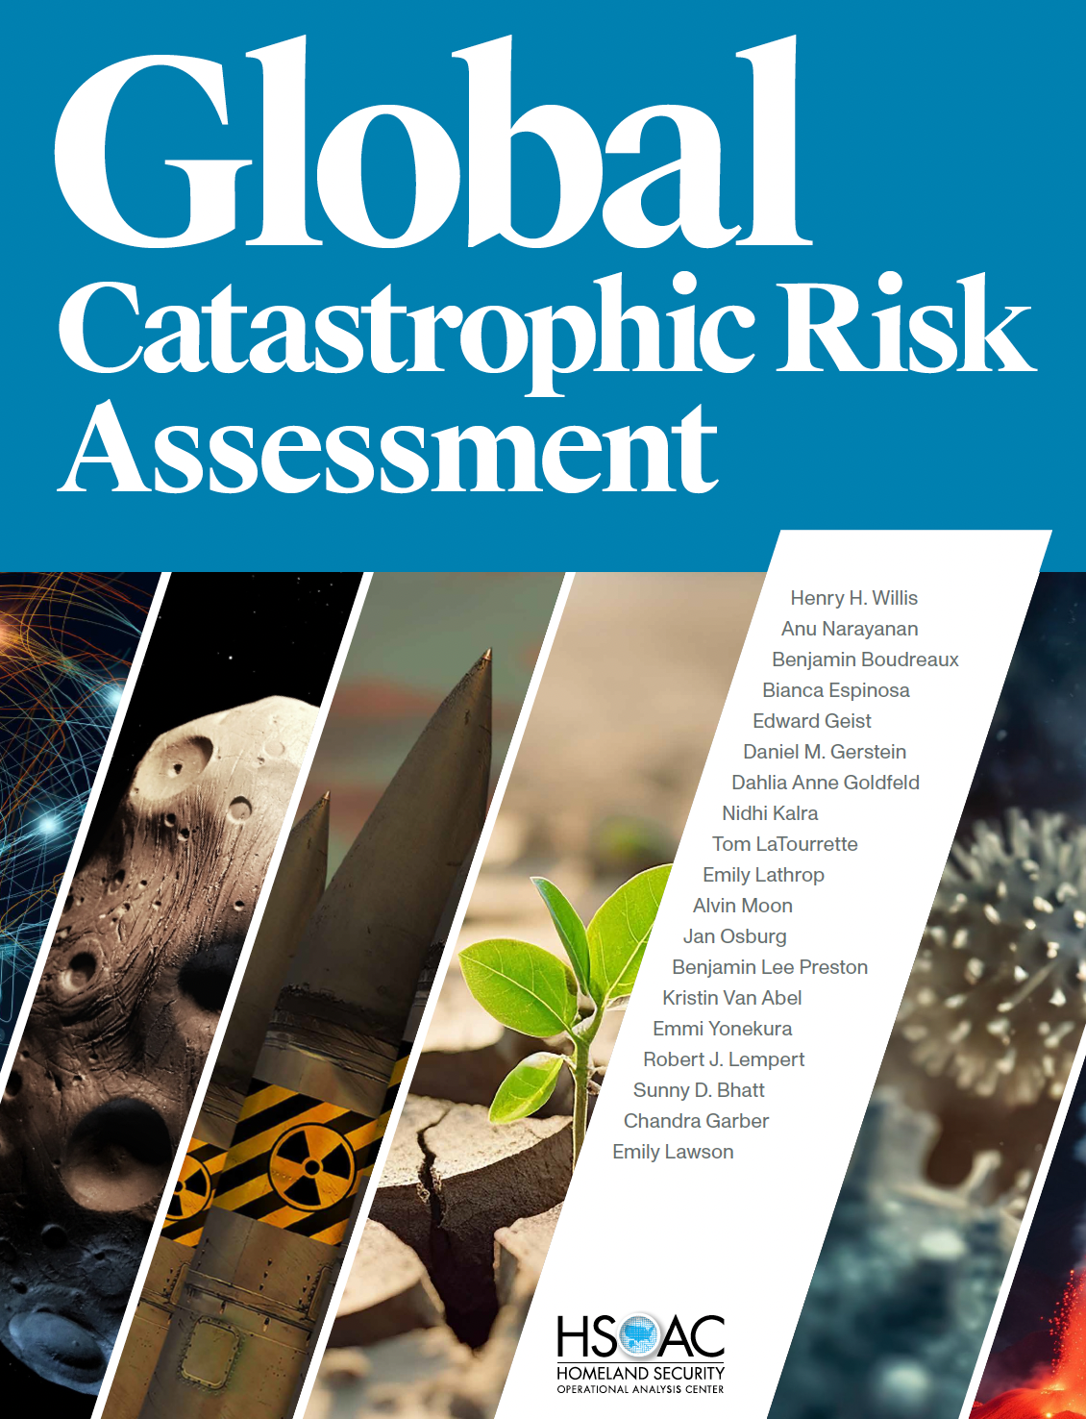
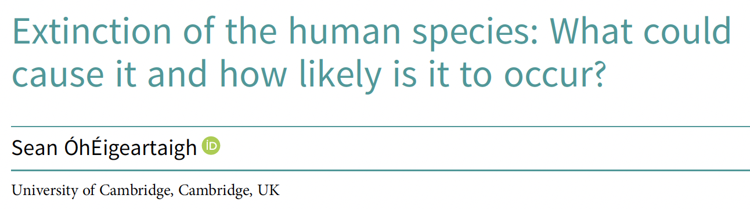
Global catastrophic & existential risk studies
From Disaster Response to
Anticipatory Governance:
Boyd & Wilson
(2025)
RAND 2024

Slide 4
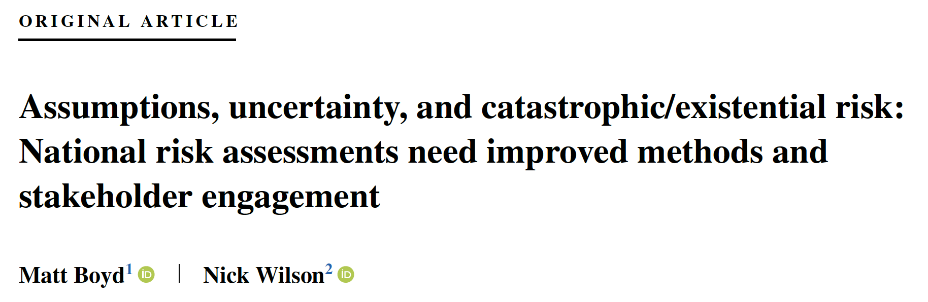
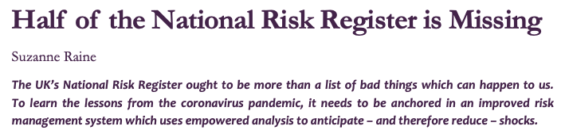
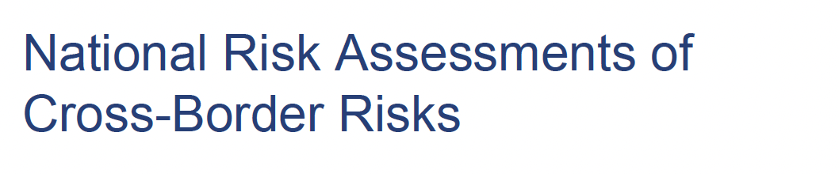
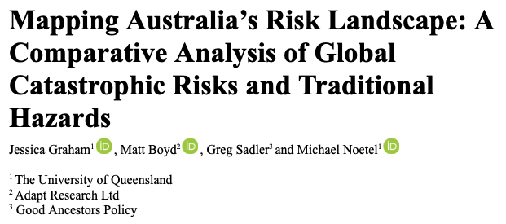

National risk assessments

Slide 5
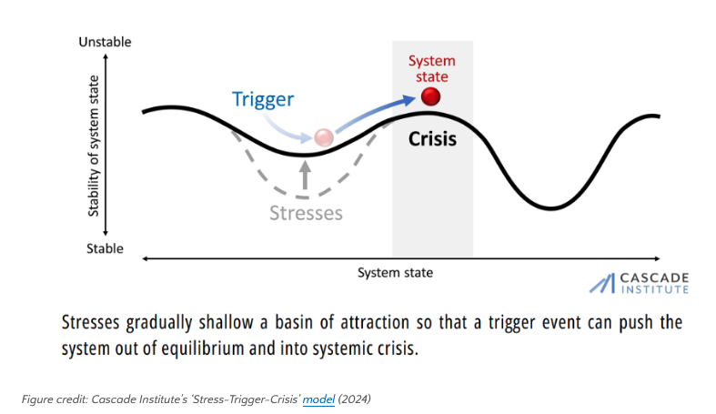
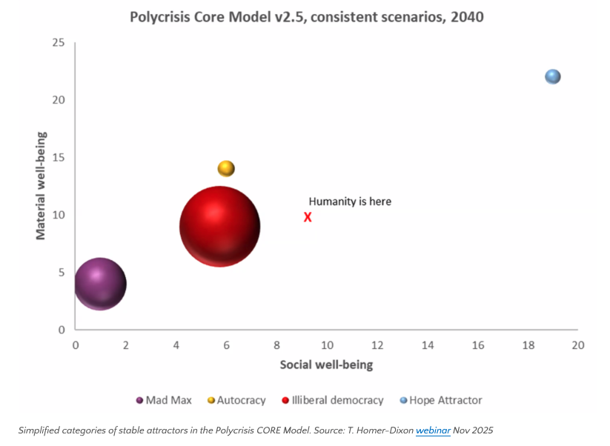
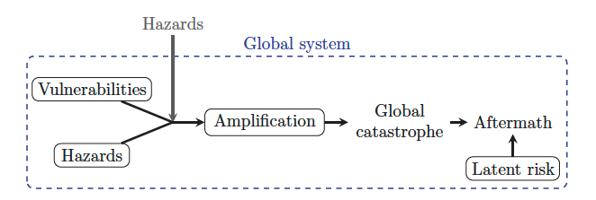
Systemic risk & polycrisis studies
Arnscheidt et al. 2025

Slide 6
Causation: proximate vs ultimate
How?
  Mechanism
  Development
Why?
  Function
  Origins
Human Behaviour
Evolutionary Dynamics (invisible hand)

Slide 7
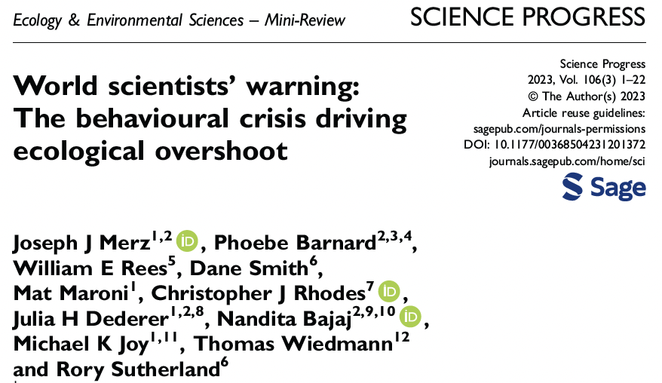
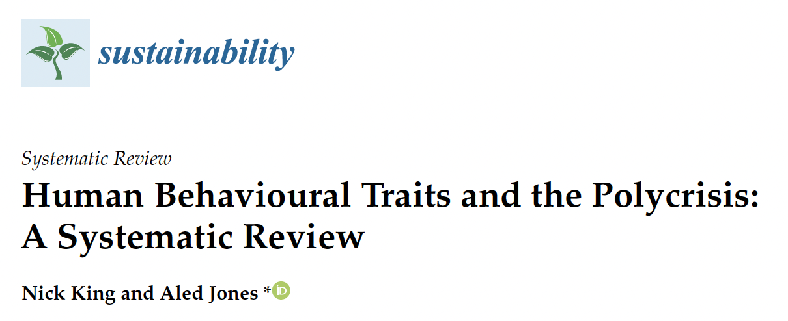
Human behavioural studies

Slide 8

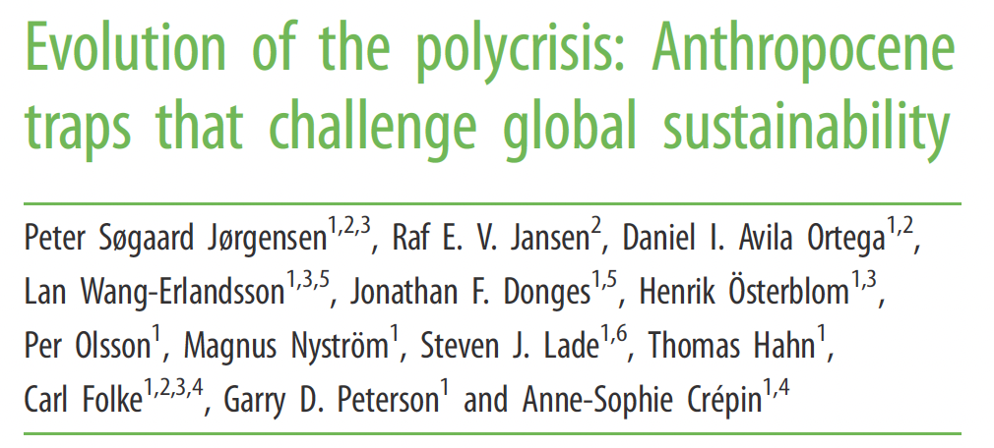
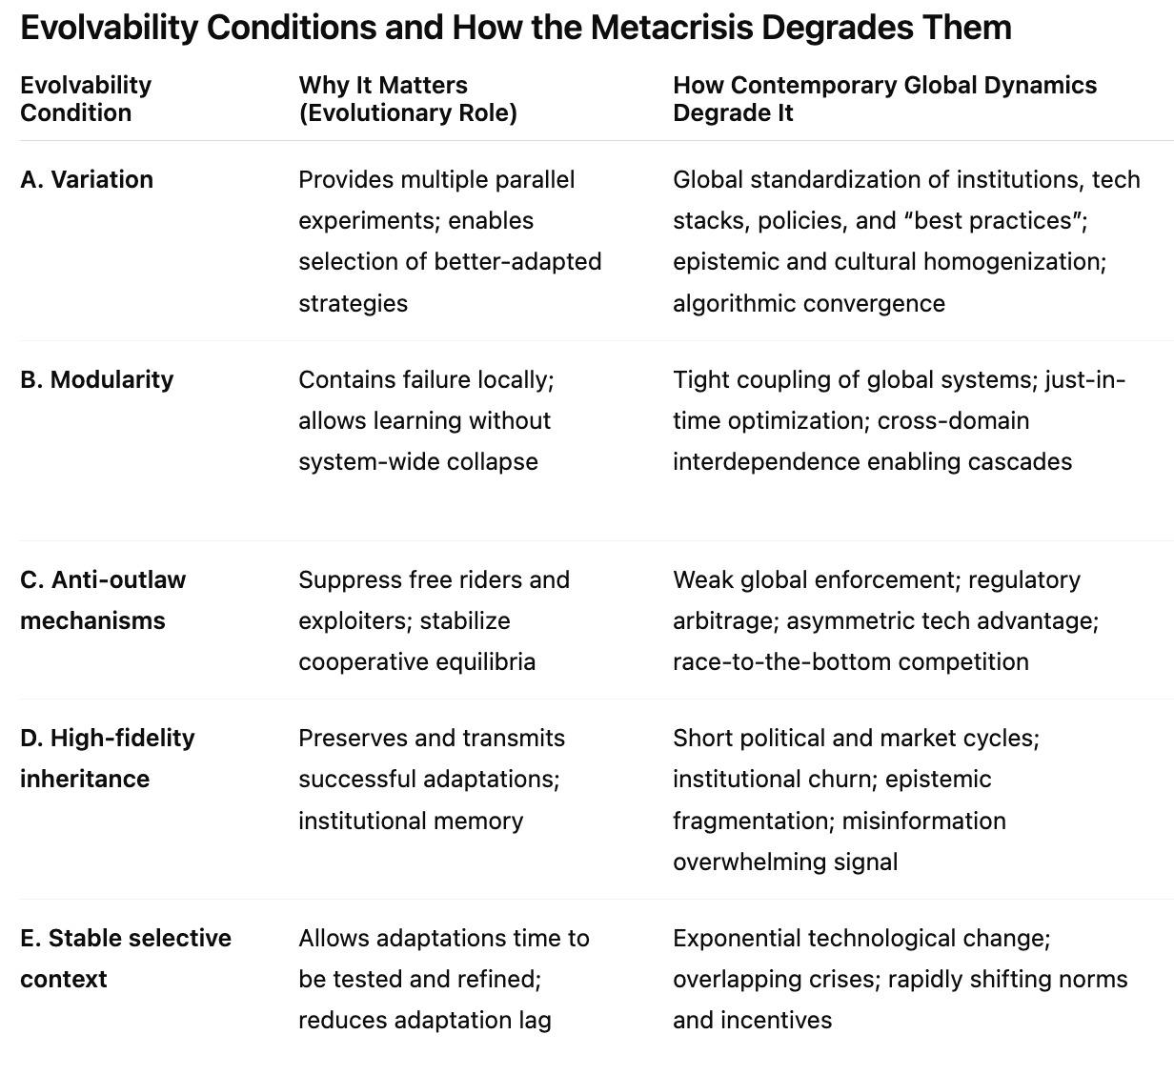
Evolution & evolvability
Five high-level capacities:
1. Recognizing traps and setting goals
2. Measurement, learning, and foresight
3. Reorganizing and innovating
4. Being prepared for surprise (diversity, redundancy, modularity)
5. Navigating conflict across scales

Slide 9
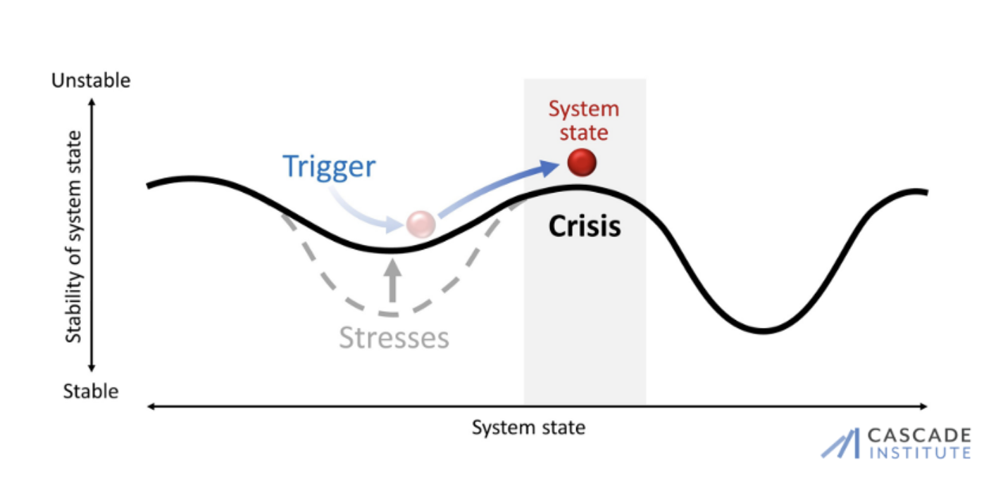
Global catastrophic risk hazards
- Endogenous or exogenous
Adaptation &
Antifragility
BAU chaos
DRR
Respond risk
(adapt)
Catastrophe/collapse
Reduce risk
(transform)
Governance &
National Risk Assessment
Stresses & behaviour
- 14+ global stresses
- Human cognitive biases
Evolvability
- Variation & modularity
- Anti-outlaw mechanisms
- Information fidelity
(create vulnerability)
(possibility space search)

Slide 10
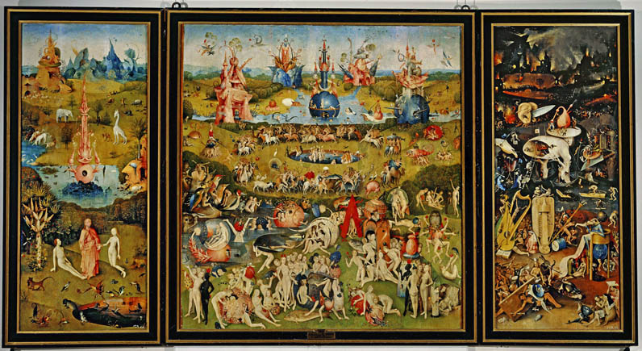
Is there a “metacrisis”?
From Disaster Response to
Anticipatory Governance:
Boyd & Wilson
(2025)

